Slide 1
Game_tracker
Discord Bot for Valorant Players
Suchit Pinreddy
Vedant Supnekar
Isha Koregave
Dhruv Maniar

Slide 2
Take your Valorant gameplay to the next level with game_tracker ‘s 5 commands
/stratroulette
/agent
/maptips
/agent_tips
/shootingtips
Notes:
Isha
Looking to take your Valorant gameplay to the next level? Look no further than the ultimate companion for any Valorant player - the HackwesTX Discord bot! With five incredible functionalities, this bot will keep your gameplay fresh, exciting, and full of tips and tricks to improve your skills. Feeling indecisive about which agent to choose? Let the bot randomly select one for you with the Agent Roulette function. Looking for a new challenge? The Strat Roulette function will select a new type of gameplay to keep you on your toes. And if you need help improving your skills, the Agent, Map, and Shooting Tips functions are here to give you the advice you need to become a Valorant master. Don't miss out on the opportunity to elevate your gameplay and become the ultimate Valorant player with the HackwesTX Discord bot!

Slide 3


Command 1 - Agent
/agent
Randomly selects an agent to play with.
Increasing the player's versatility and improving their gameplay
Notes:
Isha
The Agent Roulette function allows Valorant players to randomly select an agent to play with. The bot randomly selects an agent from the roster and displays it in the Discord chat. This function is useful for players who want to switch up their playstyle or try out a new agent. Here's a screenshot of the bot in action: [insert screenshot]. The benefits of using this function include increasing the player's versatility and improving their gameplay.

Slide 4

Command 2 - Strat Roulette
/stratroulette
Randomly selects a type of gameplay for the team to play with.
Useful for players who want to add an extra challenge to their gameplay
Notes:
vedant

Slide 5
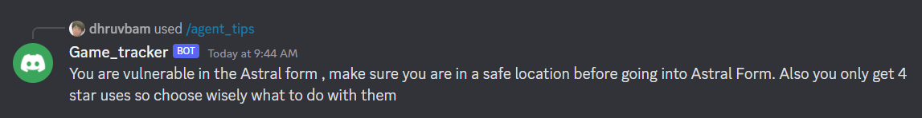
Command 3 - Agent Tips
/agent_tips
provides players with tips and tricks for the agent they are playing with.
useful for players who want to improve their gameplay with a specific agent.
Here's a screenshot of the bot in action: [insert screenshot].
benefits - improving the player's understanding of the agent and increasing their chances of winning.
Notes:
vedant

Slide 6
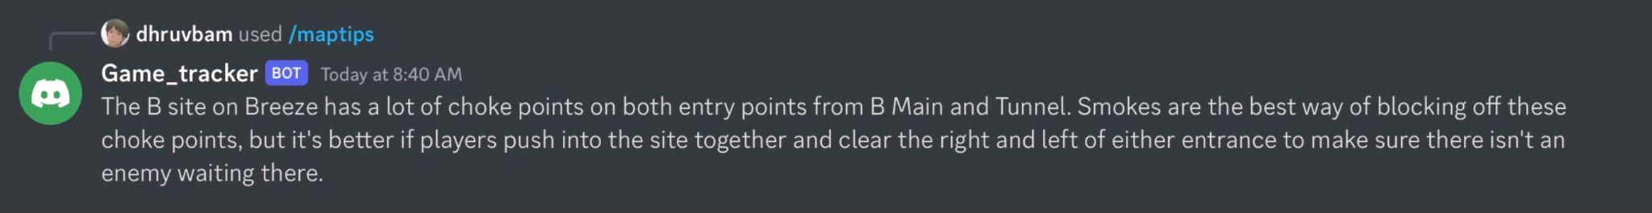
Command 4 - Map Tips
/maptips
tips and tricks for the map they are playing on.
useful for players who want to improve their gameplay on a specific map.
Here's a screenshot of the bot in action: [insert screenshot].
Benefits: improving the player's understanding of the map and increasing their chances of winning.
Notes:
Dhruv
The bot displays helpful information such as common chokepoints, angles, and callouts helpful information such as

Slide 7
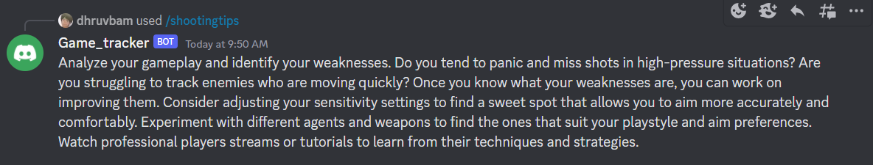
Command 5 - Shooting Tips
/shooting_tips
tips and tricks for improving their aim, shooting, and headshot percentage.
useful for players who want to improve their aim and overall gameplay.
Here's a screenshot of the bot in action: [insert screenshot].
benefits - improve player's aim’s accuracy and increasing their chances of winning.
Notes:
Dhruv
The bot displays helpful information such as crosshair placement, spray control, and flick shots.

Slide 8
Technologies Used
Discord bot commands written and run locally in Python
Backend for discord bot command written and run on cloud(GCP) in Python ->python code stored in git
Data used for python backend -> stored in -> SQL databases-> containing info like agent names, map name etc -> in GCP
Flask -> used to tie Discord to Backend Python code to make it global
Deploy app to GCP -> using Cloud Engine
Notes:
Suchit

Slide 9
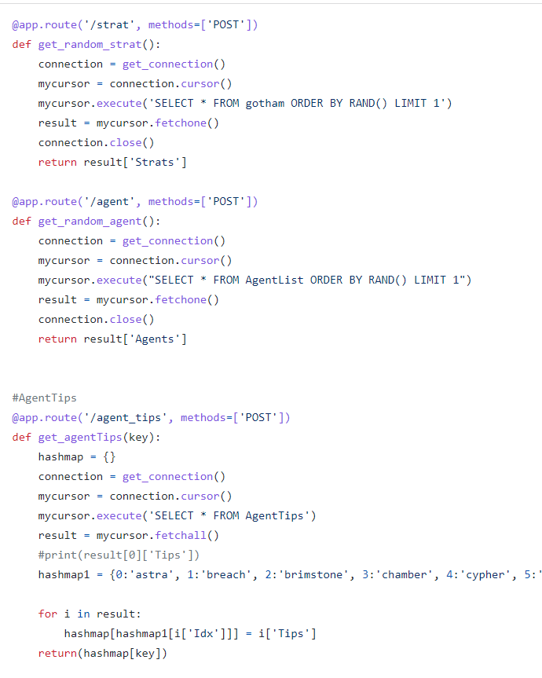
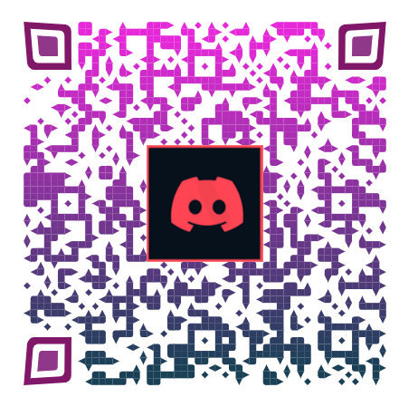
Q&A
Notes:
Isha conclude, vedant q/a

Slide 10
